Slide 1
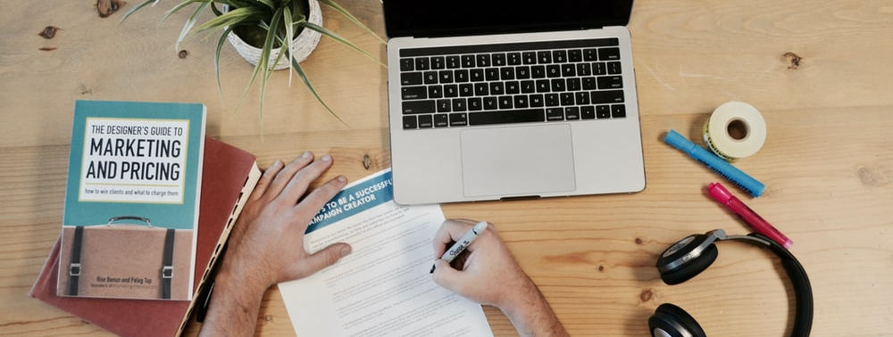
START YOUR ONLINE STORE…

Slide 2


New Authorized Seller For Mavis
Objective: want to draw traffic to store with promotion

Slide 3
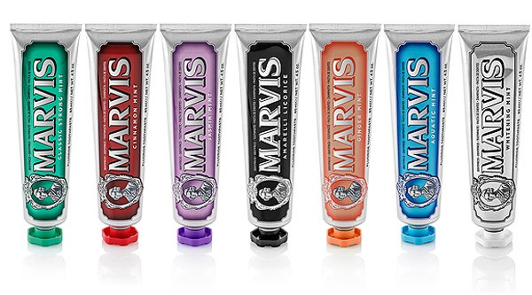
Premium Toothpaste 600 Baht

Slide 4
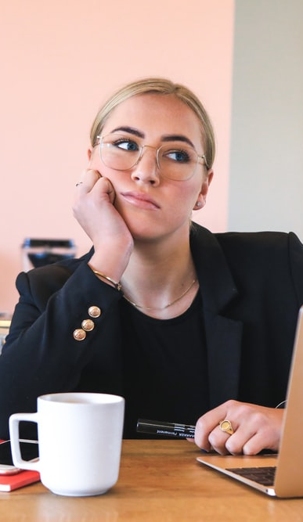
Problem
The seller never open an online store on any platforms. The marketing team endlessly discuss which promotion would be more attractive for customer on Lazada. Because of new to this platform, the team do not have any data about customer in Lazada at all.

Slide 5

Sampling: Lazada Shoppers

Slide 6
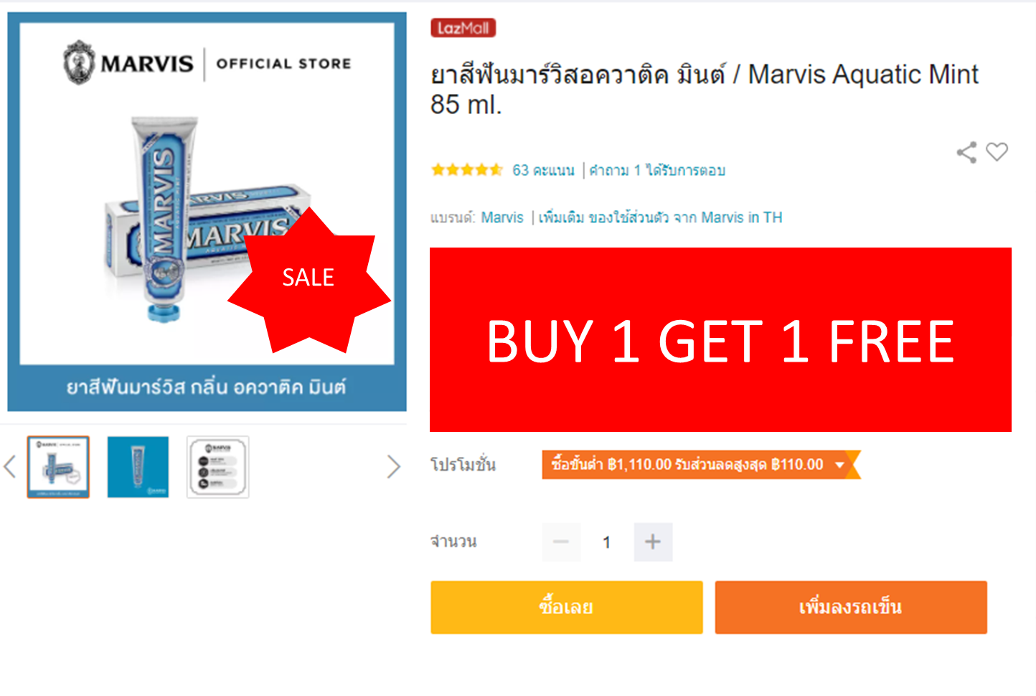
1st Promotion
Buy one
Get one
A

Slide 7
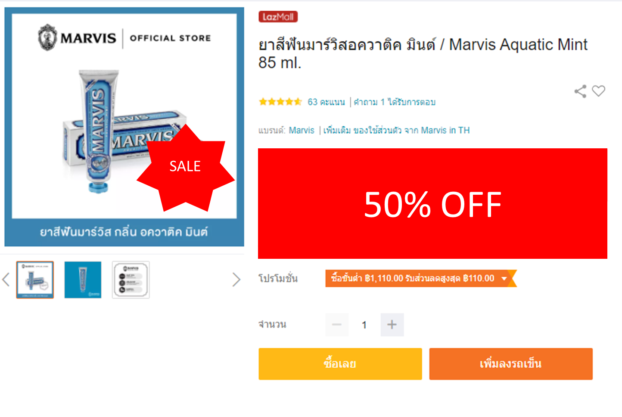
2nd Promotion
50% Off
B

Slide 8
Hypothesis
H0: 1st Promotion : 2nd Promotion 0.5 : 0.5
H1: Not H0

Slide 9
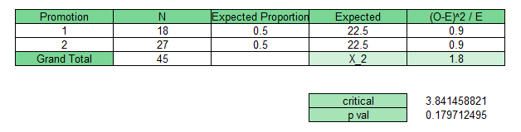
Result from 45 respondents

Slide 10

Solution
The seller can choose any promotion to draw traffic.
The confidence level at 95%, so the decision has a chance to mistake only 5%
Next should test different between who are new to product and are not.

Slide 11
THANK YOU
GROUP 4
ศิริพงษ์ มนัดดา ภูริภัทร คเณศ สมสกุล

